Slide 1
Presentation 2 Peer -Programming
COIT11241
JAMIE SHIELD TERM 2 2023
CHELSEA AJISAKA
FRANCIS RENZAHO
MATHEW GALLEHAWK

Slide 2
Topic 2 Implement safeguard CIS 2.5 Allowlist Authorized Software
Background
You work at the Monto Caravan and Cabin Park.
Your boss has asked you to improve the cybersecurity of her workstation.
Develop a portfolio of evidence of the implementation and testing of a safeguard.
Your boss uses the Win11 virtual machine
To implement an allowlist of authorised software you will configure Windows Defender Application Control (WDAC) in Win11.
Task
Create 1 script called defend.ps1 with 4 functions:
testWDAC() – opens an untrusted app, and logs success or failure.
setupWDAC() – compiles a block policy.
enableWDAC() –applies block policy.
resetWDAC() – removed the block policy.
Utilise GitHub for version control, project management & peer programing.
Test the solution and present to stake holders.

Slide 3
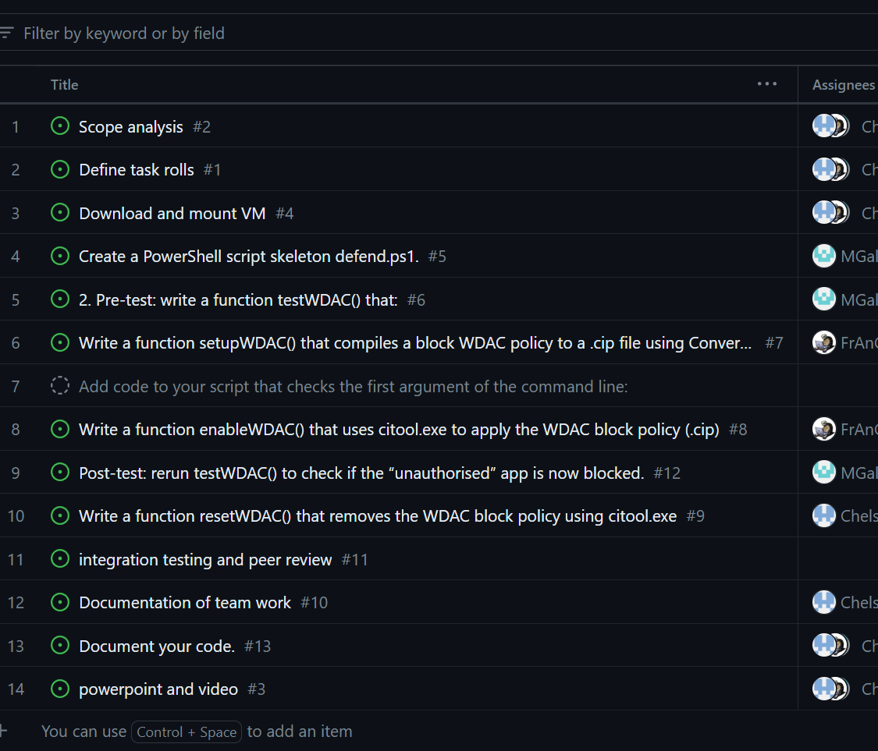
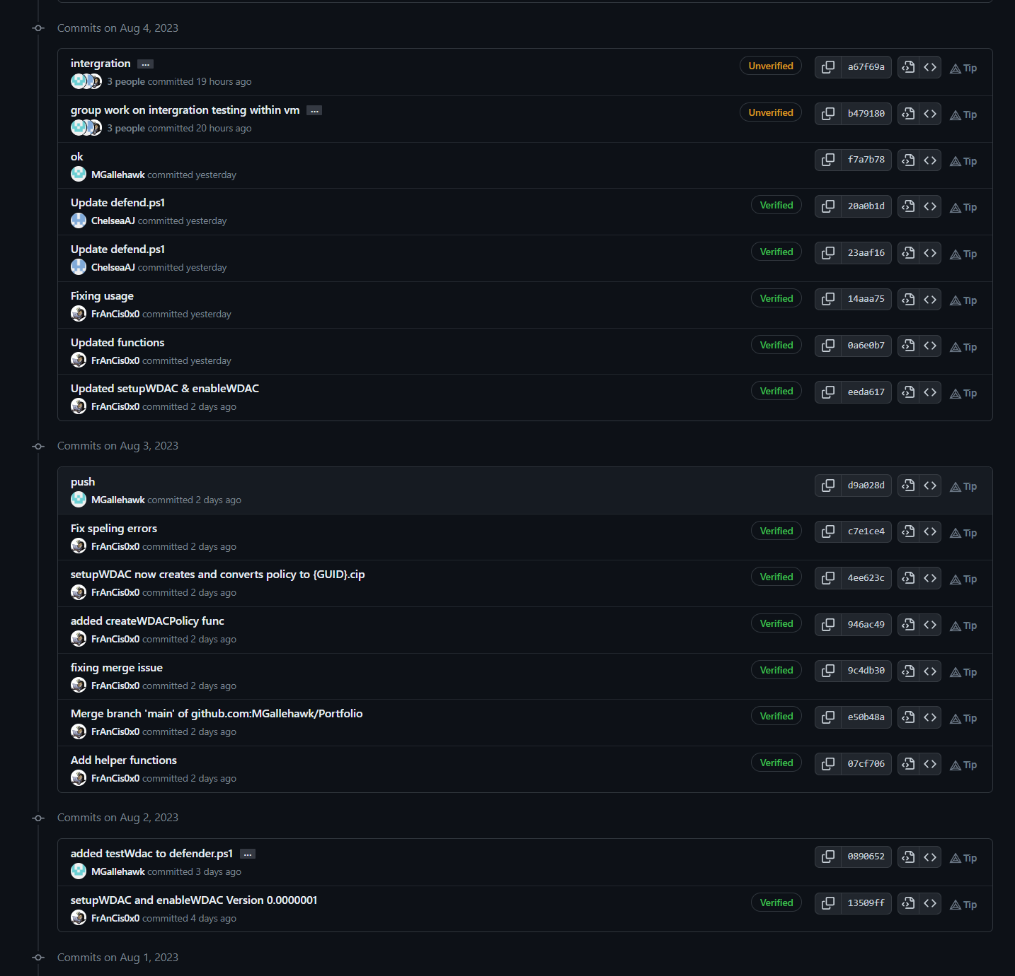
Communication & Team Management
Git-Hub
Used to work on the same project at different times.
Comments and notes in the commits help to understand and review change.
Able to keep everyone working on the same project.
Projects
We used projects within Git Hub to manage what need to be done and who is responsible.
Teams
We used teams for our talk about channel, as well as our meeting platform.
Team Viewer
We used team viewer to share access to a VM for integration testing.

Slide 4
Obstacles
Time
Virtual Machine test Environment.

Slide 5
TestWDAC()

Slide 6
setupWDAC()

Slide 7
enableWDAC()

Slide 8
resetWDAC()

Slide 9
Implementation Tetsting

